Slide 1
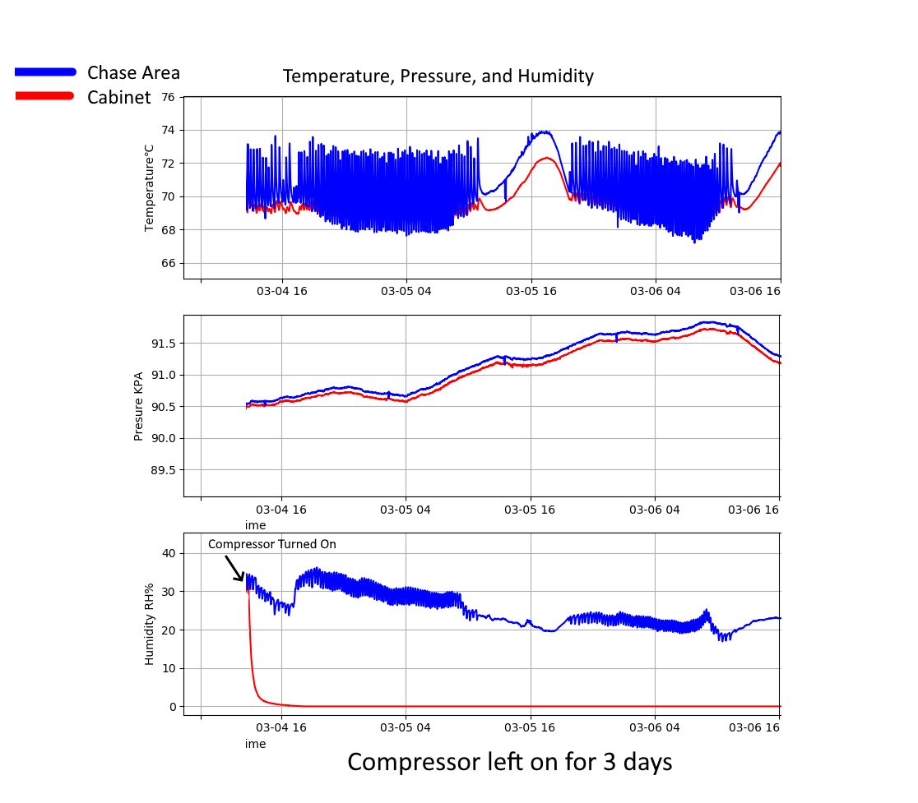
Long Duration Compressor Test
-Compressor was turned on March 3rd at approximately 2pm.
-Cabinet was kept at ~0% humidity for the entire time the compressor was left on.

Slide 2
Cabinet Humidity Flow Rate Tests
On the next slide
-Tested 3 different flow rates for air into the cabinet, with 2 runs for each flow rate.
-The difference between 100% and 50% flow rate did not double the time needed for the cabinets to reach 0% humidity.
-The 5% flow rate resulted in an increase of 15% from the 100% flow rate test.

Slide 3
